Slide 1
Introduction to Java for C++ Programmers
Introduction to Database
By: Mahboob Ali

Slide 2
Database Terminology
Database: The container for all data that you store.
Sqlite: The entire database is stored in a single file.
Database Dictionary: provides a comprehensive list of the structure and types of data in the database.

Slide 3
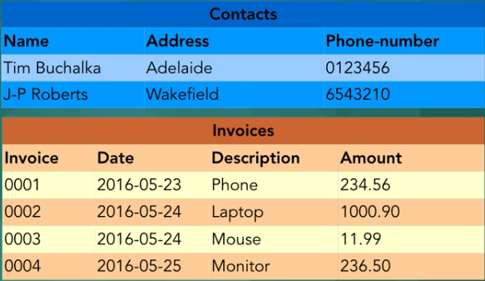
Table: a collection of related data held in database.

Slide 4
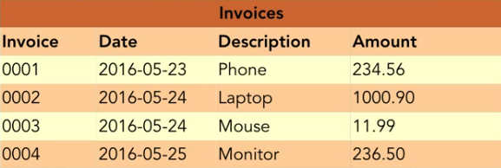
Field: the basic unit of data in a table.
The Invoice table has Invoice, Date, Description and Amount fields.

Slide 5
Column: is another name for field.
This can be confusing, but relational databases existed before spreadsheets.

Slide 6
Row: a single set of data containing all the columns in the table.
The Invoices table has 4 rows, called records.
One record

Slide 7
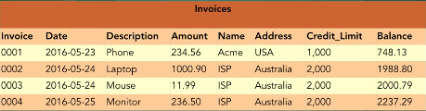
Flat File database stores all the data in a single table. Like Excel sheet
This results in a lot of duplication.
Not popular anymore.

Slide 8
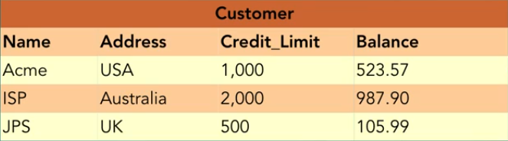
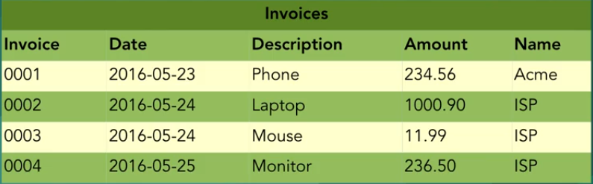
A relational database is a digital database based on the relational model of data.
Join
1:M

Slide 9
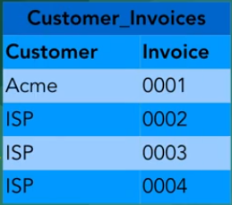
Relational Model represents how data is stored in Relational Databases.

Slide 10
Database normalization, or simply normalization, is the process of restructuring a relational database in accordance with a series of so-called normal forms in order to reduce data redundancy and improve data integrity.

Slide 11
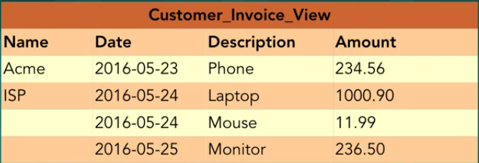
A view is a selection of rows and columns, possible from more than one table.
In SQLite view can not be updated.

